Slide 1
How to Write a Press Release
Insert your agency name here

Slide 2
Overview
What is a Press Release?
A Press release is simply a written statement distributed to the media to announce a range of news items: scheduled events, news, awards, programs or services, sales or accomplishments.
Notes:
Press release is simply a written statement distributed to the media to announce a range of news items: scheduled events, news, awards, programs or services, sales or accomplishments. They may generate a feature story as reporters are more likely to do a story if they first receive a release. It is a fundamental tool of Public Relations work, and moreover, it is one that anyone who's willing to adopt a proper format can use successfully.

Slide 3
Generally speaking, a press release is as short as possible –one-half to one page is excellent, two pages too wordy and three pages excessive regardless of how complex the topic.
Notes:
Generally speaking, a press release is as short as possible –one-half to one page is excellent, two pages too wordy and three pages excessive regardless of how complex the topic.
The headline and your first sentence are the two most important parts of a press release. Make sure they are compelling enough to draw the editor or reporter in. Use active verbs in headlines, making them brief and to the point.

Slide 4
From the Beginning
1
Notes:
1. Your press release should begin by using letterhead. Letterhead provides the media with contact information that may not be on your press release.

Slide 5
timing
Align Text Right
2
FOR IMMEDIATE RELEASE
July 31, 2013
3
Single spaced line
PRESS RELEASE
Rodney Queen, Senior Activities Coordinator
336.474.2754
Rodney.queen@davidsoncountync.gov
Double space after contact info.
Notes:
2. Number 2 is timing. The timing of the press release is very important; it must be relevant and recent news or information. If it is for immediate release, clearly indicate so by writing “FOR IMMEDIATE RELEASE" in caps on it to the left.
If it is to be released later, clearly indicate the date you want the story released. Remember, the absence of a release date presumes immediate release.
3. Next line (aligned to the left) What is the Document? Press Release (in all Caps)
Who is the contact? – The Contact is the person who has written the release. It can be as simple as name, title, phone number and email.

Slide 6
Press Release Body or Copy:
4
Always write in the 3rd person.
Lexington, NC – Davidson County Senior Service, Senior Dynamics program will be hosting a fundraiser supporting Senior Center programming, Saturday, August 20, 2pm - 5pm. The event will be held at the Lexington Senior Center, 555-B West Center Street Ext.
County residents, age 55 and older are invited to attend. Tickets are $10 and available at the Senior Center in Thomasville, 211 West Colonial Drive or Lexington, 555-B West Center Street Ext. (You would not have to put the Lexington address b/c you just stated it in the 1st paragraph, either way is fine.)
Come and enjoy a day full of food, fun, music, and raffles. Each ticket purchased includes a Pita sandwich, Hummus or French Fries, a drink, one raffle ticket and a complimentary subscription to Our State magazine. “This event is a first of it’s kind. We have arranged for staff to provide entertainment,” states Christy Smith, Senior Center Manager.
Notes:
Now you are ready to start working on the press Release Body or Copy: You may be asking “What about the Title?” We will come back to the title.
CLICK
First rule of thumb is always write a press release in the third person. Don’t use, “we”, “us”, “our”, “I”,
Start with the city and state in which the press release is originated.
The press release body should be written in a manner that informs people and does not try to sell them something. A very easy way to start off is by summarizing the entire release. The first two paragraphs should answer the questions, "who?", "what?", "when", "where", "why", and how can one attend and "how much?".
CLICK ONCE
So, let’s look this body and see if it answers the 5 W’s and 2 H’s. Ask Various Staff to show me each of these.
The next paragraph gives more details of what people can expect at the event. *Be sure to include quotes from people involved in the story. Quoting a person by name helps readers understand and remember the information more clearly.
Keep the total length of the body under 500 words, but at least 100.

Slide 7
The boilerplate
5
Senior Services, a division of Davidson County Government, was established in 1975. The organizations mission is to offer an array of programs and services to older adults regarding their well-being, independence, involvement in their community and the ability for them to remain in their own home.
Notes:
The press releaser boilerplate or “boiler” is the about us section of the press release. It is a paragraph or two that describes the company and it’s products or in our case, Senior Services.
Boilerplate text can be reused over and over without any change.

Slide 8
close
6
For more information on this event or other Senior Services programs call 336.242.2290 or go online to www.co.davidson.nc.us/seniorservices
Notes:
The close of the press release is the second paragraph of the boilerplate, letting readers know how they can obtain more information about the event or the agency.

Slide 9
Hash symbols – the end.
7
Notes:
(Click) - Signal the end of the press release with three # (hash) symbols, centered directly underneath the last line of the release.

Slide 10
Additional info. for the press
8
If you would like more information about this press release or to schedule an interview with Rodney Queen, please contact Thessia Everhart-Roberts at 336.242.2290 or email thessia.everhart@davidsoncountync.gov
Press
Note
Notes:
This is where you can let the press know the contact for additional information on the event or to set up an interview. This is your note to the press.

Slide 11
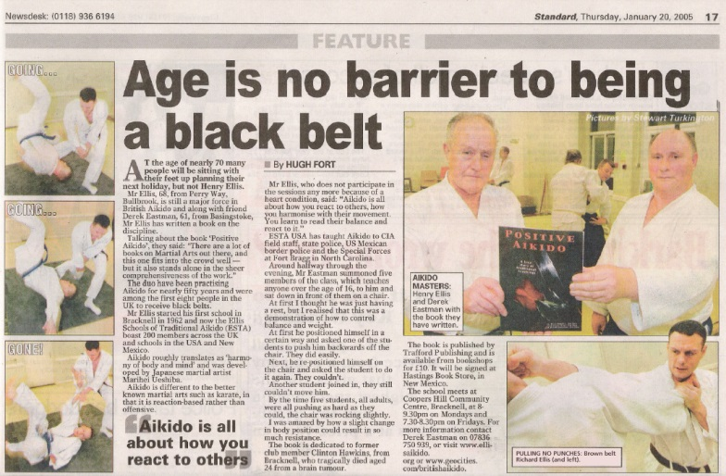
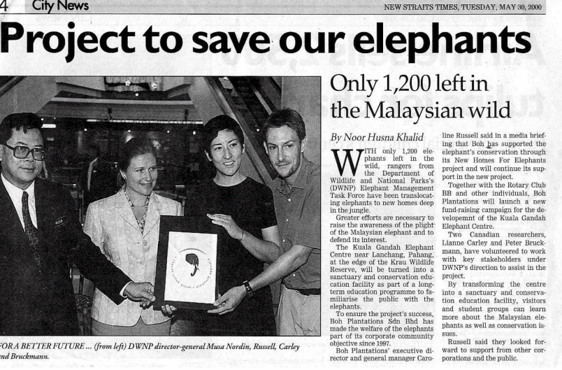
Write Your Headline Last
9
Food and fun abound at senior center fundraiser
This is where you would place a sub-title if needed
Title
Sub-title
Notes:
Only when you have drafted and revised your release do you determine your headline.
The headline is your chance to be noticed, but nonetheless must be concise and factual. Headlines are written in bold and are a larger font than the press release text
A headline should have a "grabber" to attract readers even as a headline is meant to grab readers. (food)
The simplest method to arrive at the press release “grabber” headline is to extract the most important keywords from your press release. From the keywords, try to frame a logical and attention-getting statement.
Your headline should be brief, clear and to the point:
The first word in the press release headline should be capitalized, as should all proper nouns, but do not capitalize every word. ** According to the Assoicated Press Style, your headline should be set as a correct sentence capitalizing on proper nouns and their first word of the headline.
If needed you can place a sub title in the press release font size and non bold, below the title.

Slide 12
Do a Critical Review of Your Press Release:
Are the facts right?
Is your press release on company letterhead?
Have you done a spell-check?
Are the dates /times/location correct?
Are names spelled correctly?
Is your headline a “grabber”?
Did you answer the 5 W’s and 2 H’s?
Did you include a boilerplate?
Signal the end of the press release with three ### symbols, centered directly underneath the last line of the release (this is a journalistic standard).
Did you note to press how they can obtain more info. or an interview?
Is all contact info. included?
Did you state when you want it ran?
Notes:
Do a Critical Review of Your Press Release: Review/double check all facts and the information. Ask yourself the following questions:
• Read off slide (click one at a time)

Slide 13
HANDOUT 1
Notes:
The information I just reviewed is on the back of your press release handout.

Slide 14
Now it’s your turn
Using the information you have learned and your handouts,
take the event flyer you have been given and write a press release.
If the flyer is missing info. you can make something up.
Notes:
Read from Slide – You will have about 10 minutes. (if time permits let some read theirs)

Slide 15
Thank you for attending

